Slide 1
B92 Protocol
Graeme Jacobson

Slide 2
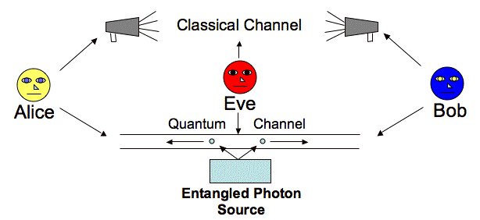
General Overview
Simplified version of BB84
Utilizes non orthogonal bases
Only two input states, not four
Less efficient than BB84
More secure than BB84

Slide 3
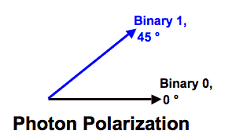
Algorithm
Alice creates a string of n bits, 0 or 1
For 0, use the state |0>; for 1, use the state |0’>
Alice sends this string of qubits to Bob on quantum channel
Bob creates random bit string of n, 0 or 1
0 measures |0>, |1> basis; 1 measures |0’>, |1’> basis
Bob takes results of 0 or 1 from each measurement
Bob sends results to Alice, keep measurements of 1
Alice’s bit string at those positions is key

Slide 4
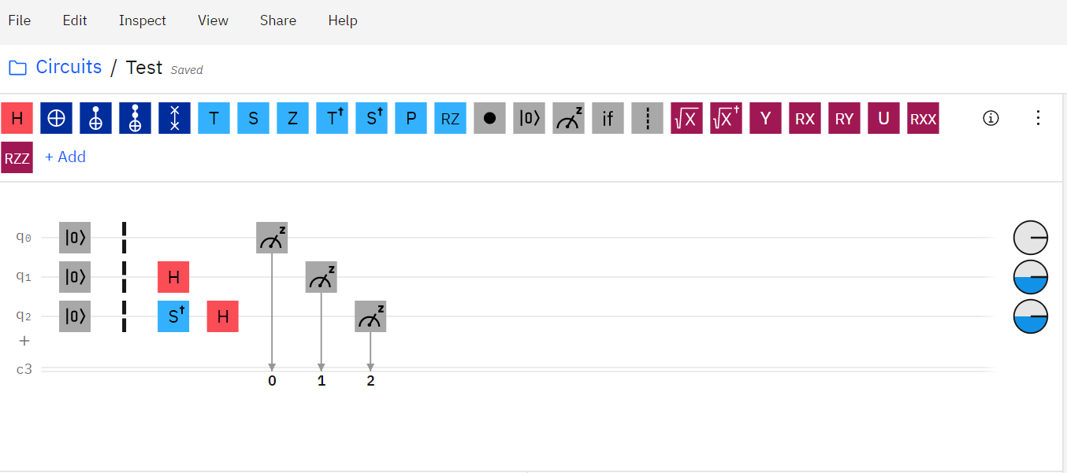
Measuring in Different Basis

Slide 5
Algorithm
a bit | 1 | 1 | 0 | 0 | 1 | 0 | 1 | 0 | 0 | 0 | 1 | 1
Alice Polarization | |+⟩ | |+⟩ | |0⟩ | |0⟩ | |+⟩ | |0⟩ | |+⟩ | |0⟩ | |0⟩ | |0⟩ | |+⟩ | |+⟩
a' bit | 0 | 1 | 0 | 1 | 0 | 0 | 0 | 1 | 0 | 0 | 1 | 0
Bob Basis | Z | X | Z | X | Z | Z | Z | X | Z | Z | X | Z
Measurement | 0 (50%) | 0 (100%) | 0 (100%) | 1 (50%) | 1 (50%) | 0 (100%) | 0 (50%) | 1 (50%) | 0 (100%) | 0 (100%) | 0 (100%) | 0 (50%)
Key |  |  |  | 0 | 1 |  |  | 0

Slide 6
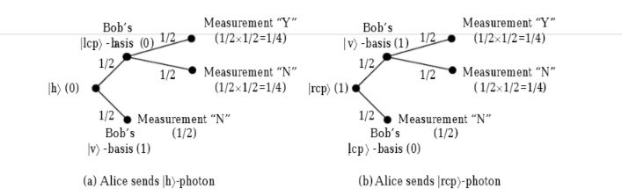
Security/Efficiency
Similar procedure to BB84
Choose section of chosen string and compare results
Eavesdropper does not know which is incorrect basis
Only ¼ of bits expected to be correct
Lower threshold on secure string

Slide 7
Key Differences
B92
Alice uses 2 states
Around 25% efficiency
Lower Eavesdropper Threshold
Two incorrect basis
BB84
Alice uses 4 states
Around 50% efficiency
Easier to detect Eavesdropper
One incorrect basis
Notes:
Mention combination of these protocols

Slide 8
References
McMahon, D. (2008). Quantum Computing Explained. Hoboken: John Wiley & Sons.
Quantum Key distribution using two non-orthogonal states. (n.d.). Retrieved October 13, 2020, from https://www.st-andrews.ac.uk/physics/quvis/simulations_html5/sims/cryptography-b92/B92_photons.html
Haitjema, M. (n.d.). A Survey of the Prominent Quantum Key Distribution Protocols. Retrieved October 13, 2020, from https://www.cse.wustl.edu/~jain/cse571-07/ftp/quantum/
Yang, Ching-Nung & Kuo, Chen-Chin. (2002). Enhanced quantum key distribution protocols using BB84 and B92.
Nielsen, M. A., & Chuang, I. L. (2010). Quantum computation and quantum information. Cambridge: Cambridge University Press.
Notes:
Checkout Neilson and Chuang
Toshiba QKD

